Slide 1
ACDNet

Slide 2
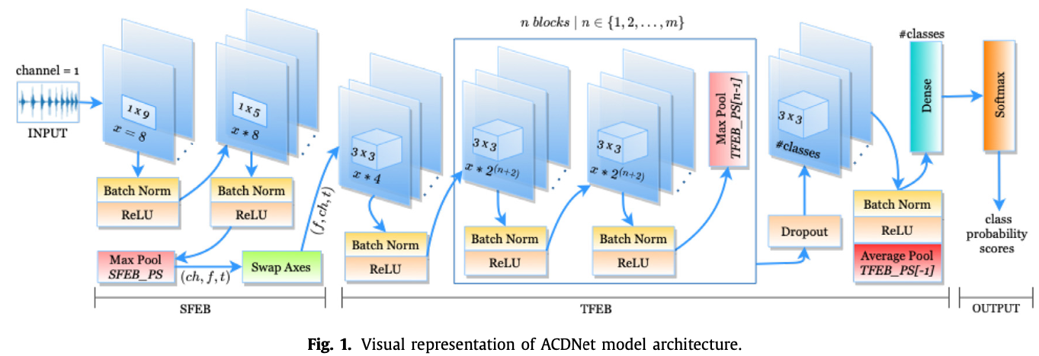
ACDNet Architecture

Slide 3
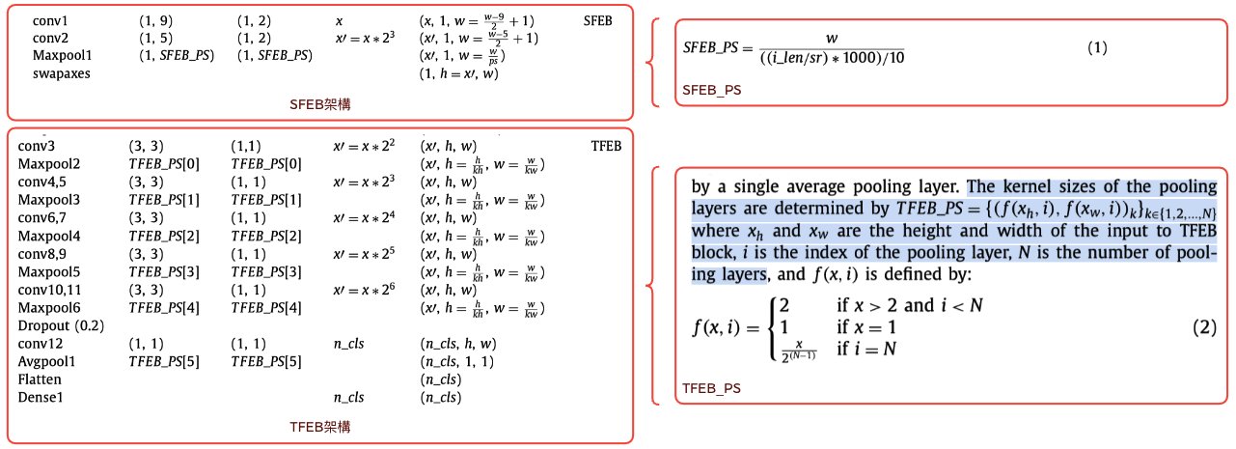
ACDNet Architecture

Slide 4
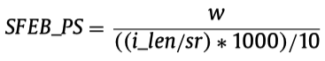
SFEB Maxpool Kernel Size Equation
Why does acdnet need to calculate maxpool layer kernel size?
It may because that the following layer‘s input size is fixed, as a result, acdnet need to calculate the kernel size for same input size.

Slide 5
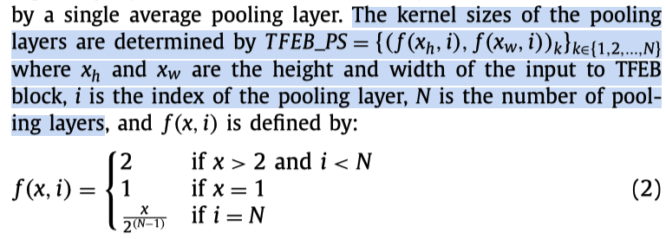
TFEB Pooling Layer Kernel Size Equation

Slide 6
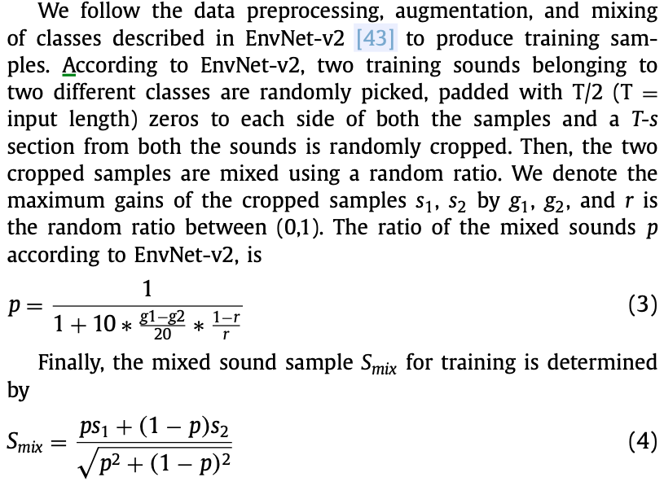
Training Audio Data Mix Equation

Slide 7
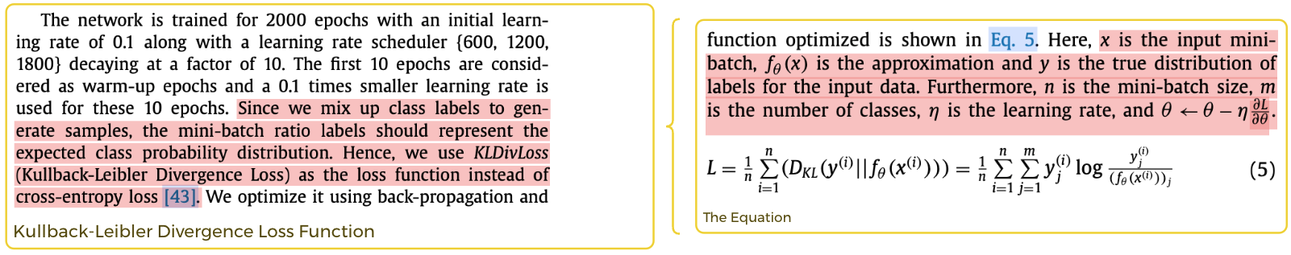
Loss Function: Kullback-Leibler Divergence Loss: why?
BC-Learning?

Slide 8
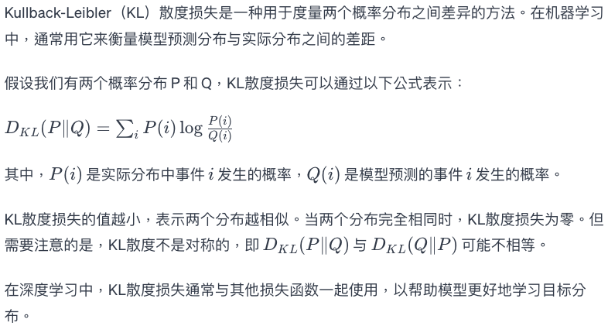
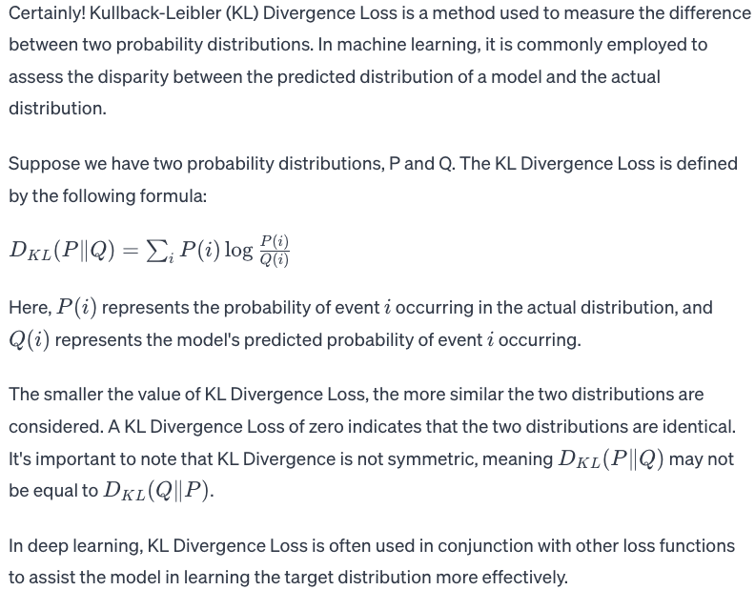
Loss Function: Kullback-Leibler Divergence Loss - explain

Slide 9
Why unstructured compression is not suitable for MCUs
Unstructured compression refers to compression techniques that do not take advantage of the specific characteristics or structure of the data being compressed. Instead, they treat the data as an arbitrary sequence of bits and attempt to reduce redundancy without considering the inherent patterns or relationships within the data.
Unstructured compression may not be suitable for microcontrollers (MCUs) for several reasons:
Resource Constraints: Microcontrollers often have limited resources, including processing power, memory, and storage. Unstructured compression algorithms might be computationally intensive and memory-demanding, making them impractical for use in resource-constrained environments.
Lack of Adaptability: Unstructured compression methods do not adapt well to different types of data. Microcontroller applications frequently involve specific types of data with known characteristics. Compression algorithms that can exploit the structure of the data can achieve better compression ratios and faster compression/decompression speeds.
Processing Speed: Unstructured compression may require complex algorithms that could be too slow for real-time applications commonly found in microcontroller-based systems. MCU applications often demand fast response times, making it important to use compression techniques that can operate efficiently within these constraints.
Energy Efficiency: Many microcontroller applications are battery-powered or have stringent power consumption requirements. Unstructured compression algorithms may consume more energy due to their general-purpose nature, making them less energy-efficient compared to compression methods tailored to the specific data characteristics.
Limited Storage: Microcontrollers typically have limited storage capacity. Unstructured compression may not be as effective at achieving high compression ratios as structured compression methods that exploit the known patterns and redundancies in the data.
For these reasons, when dealing with microcontrollers, it is often more practical to use compression techniques specifically designed for the types of data prevalent in embedded systems, taking into account the limitations and requirements of the target MCU platform.

Slide 10
Model Compression Techniques suitable for MCUs
Model compression techniques for microcontrollers (MCUs) need to consider the resource constraints of these embedded systems. Here are some model compression techniques that are suitable for MCUs:
Quantization:
Description: Reducing the precision of weights and activations from floating-point to lower bit-width representations (e.g., 8-bit integers).
Benefits: Reduces memory footprint and computational requirements.
Considerations: Balance between compression ratio and model accuracy.
Pruning:
Description: Removing or setting to zero a portion of the model's weights during training.
Benefits: Reduces the number of parameters and computations.
Considerations: Pruning criteria and threshold determination.
Knowledge Distillation:
Description: Training a smaller student model to mimic the behavior of a larger teacher model.
Benefits: Transfers knowledge from a large model to a smaller one, reducing the size of the model.
Considerations: Trade-off between accuracy and model size.
Weight Sharing:
Description: Grouping similar weights and sharing parameters.
Benefits: Reduces the number of unique parameters.
Considerations: Impact on accuracy and training complexity.

Slide 11
Model Compression Techniques suitable for MCUs (Cont.)
Low-Rank Factorization:
Description: Decomposing weight matrices into low-rank approximations.
Benefits: Reduces the number of parameters and computations.
Considerations: Balance between compression and loss of expressiveness.
Knowledge Pruning:
Description: Pruning the knowledge learned by a model, often through techniques like knowledge distillation.
Benefits: Reduces model size while preserving important knowledge.
Considerations: Proper balance to avoid loss of critical information.
Winograd Convolution:
Description: Transforming convolutional operations into a more computationally efficient form.
Benefits: Reduces the number of multiplications in convolutional layers.
Considerations: Trade-off between computation speedup and increased memory requirements.
Binary and Ternary Networks:
Description: Representing weights and activations using binary or ternary values.
Benefits: Drastically reduces memory and computational requirements.
Considerations: Balancing compression with accuracy trade-offs.
When selecting a compression technique for MCUs, it's important to consider the specific requirements of the application, such as the available memory, computational power, and the desired balance between model size and accuracy. Additionally, fine-tuning and optimization may be necessary to achieve the best performance for a given MCU platform and application.

Slide 12
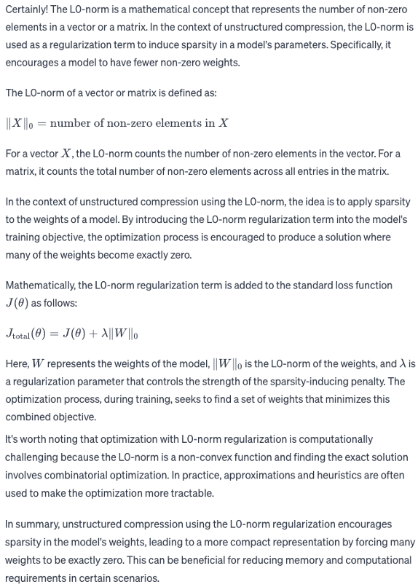
L0-Norm unstructured model compression
The idea of sparsifying the weight matrices is inspired by the fact that bringing sparsity into the network reduces the chance of model over-fitting and enhancesthe model performance [73] . Furthermore, many researchers have shown that sparse pruning of neural networks often produces the same or even better accuracy than the base network.

Slide 13
ACDNet: Model Size Shrinking
First, applying unstructured L0-Norm to model.
Second, ACDNet adapts Pruning + Quantization techniques.
Guess: since the acdnet is essentially a cnn-based model, so the author applying the best established pruning-based model compression techniques proposed for computer vision to acdnet at first.
Then, since the quantization does not conflict with other model compression techniques, hence, the author applying 8-bit quantization to acdnet to further reduce the model size.
The above is the whole picture of acdnet model compression processes. The author put emphasis on testing different pruning techniques on acdnet.
ACDNet mainly adapted channel-pruning, and it uses three approaches to achieve channel-pruning: maganitude-base ranking, taylor criteria-based ranking, and proposed hybrid pruning approach.

Slide 14
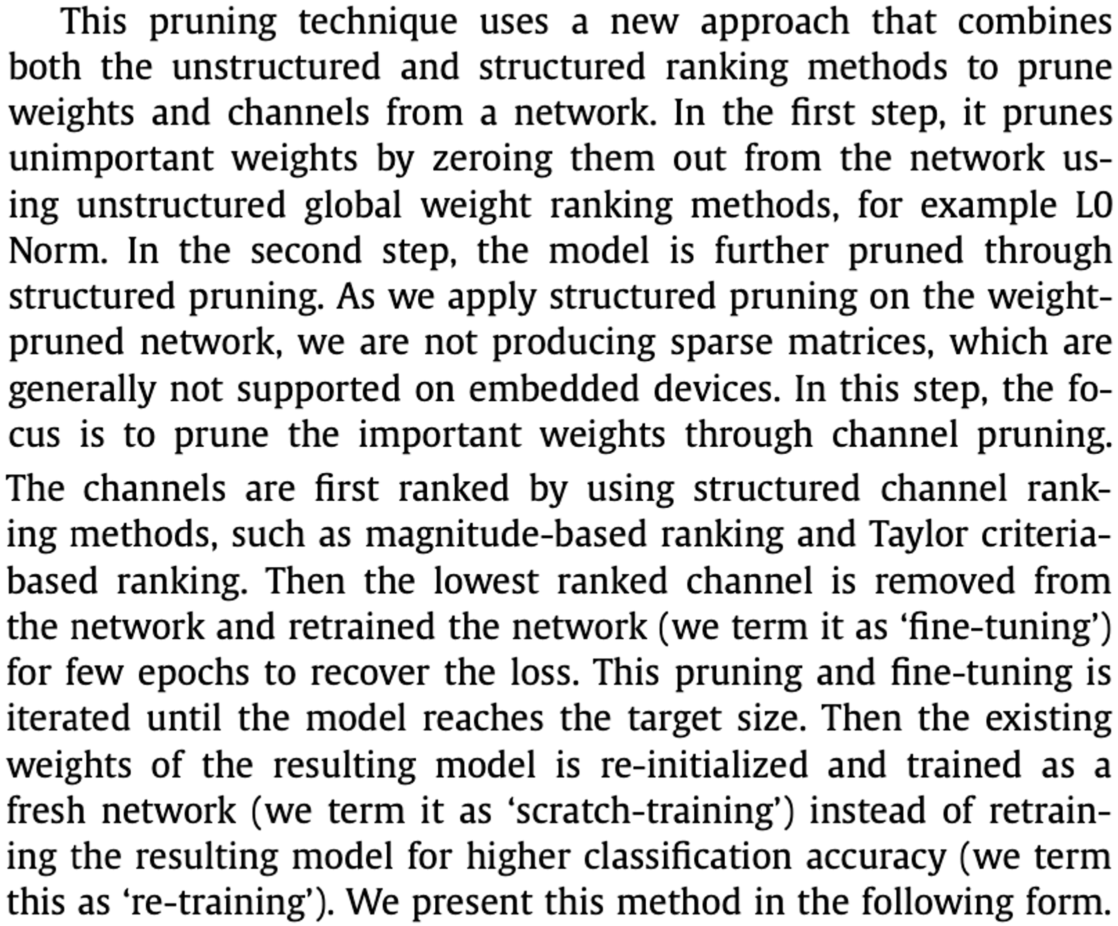
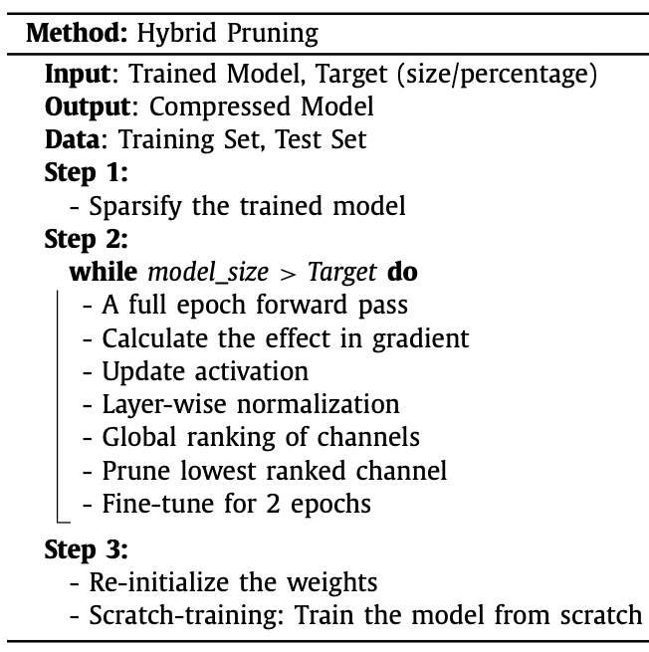
Proposed Hybrid Pruning Approach

Slide 15
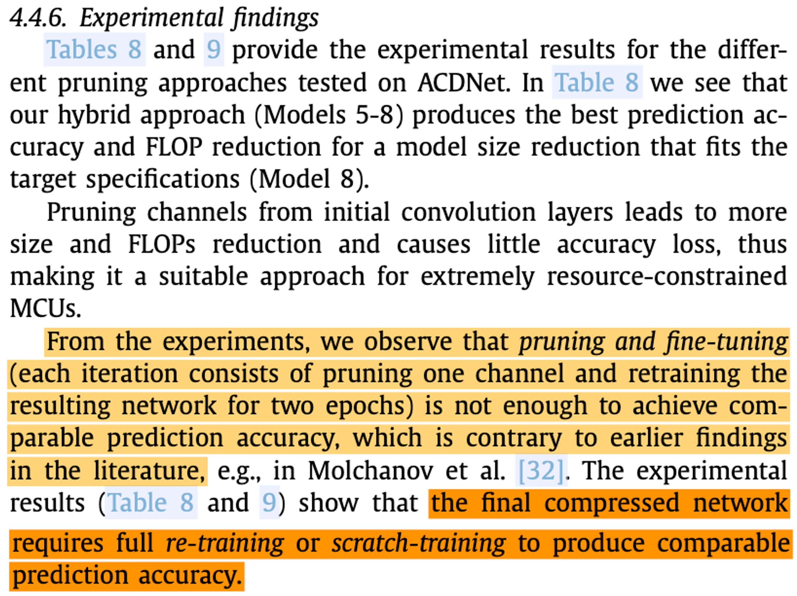
Findings

Slide 16
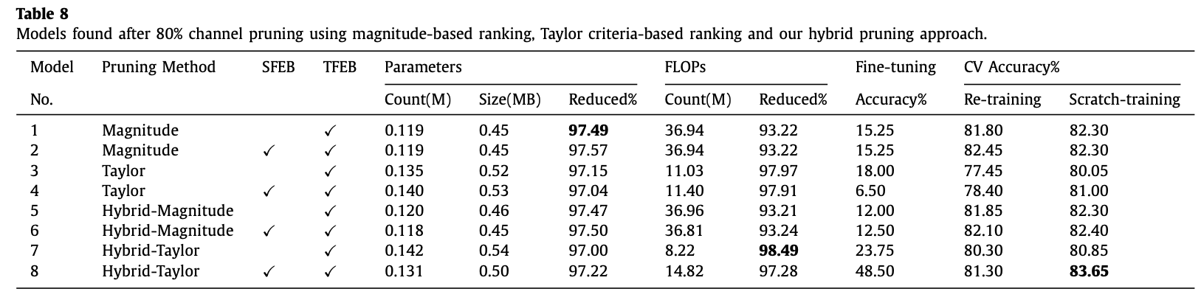
Table 8

Slide 17
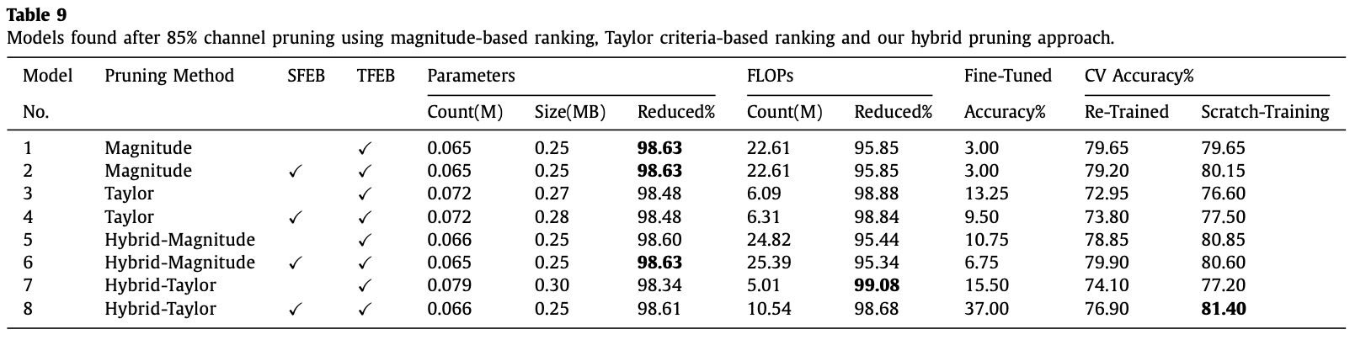
Table 9

Slide 18
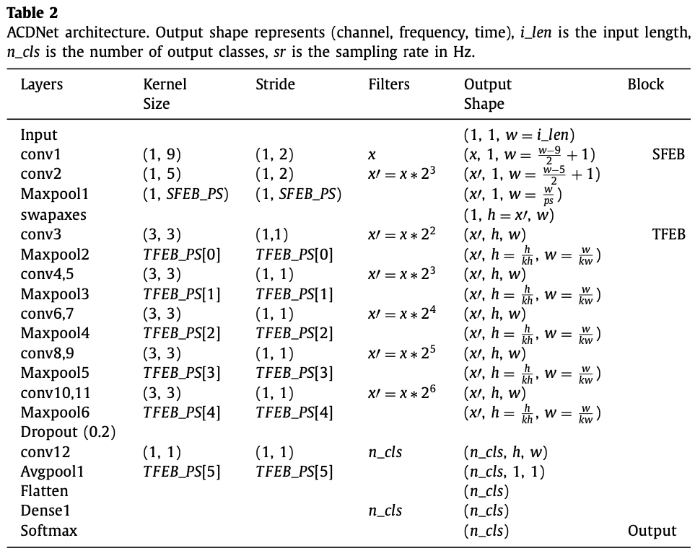
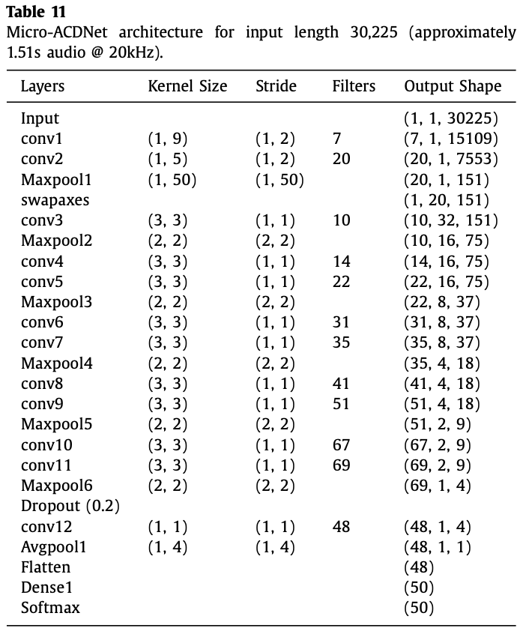
Table 2 and Table 11

Slide 19
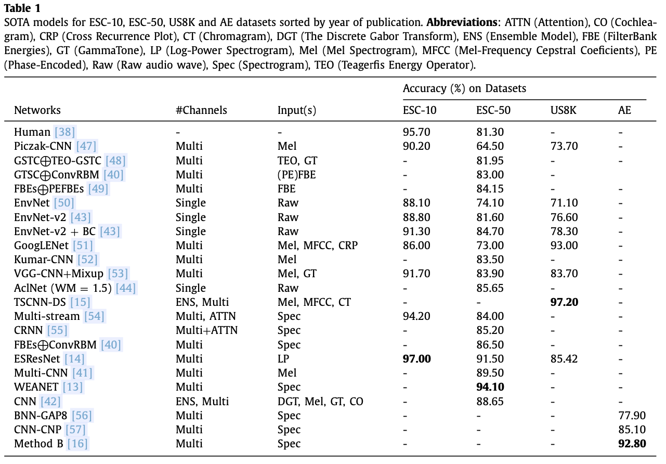
Table 1

Slide 20
Between-Class Learning(originated from EnvNetV2 Paper)

